Slide 1

TEAM-2
Train Ticket Generation
This case-study involves generating a train ticket and printing the ticket to a file.
Prasanna P
Vishwas M
Tasmiya K
Sairam S
Rohith S

Slide 2
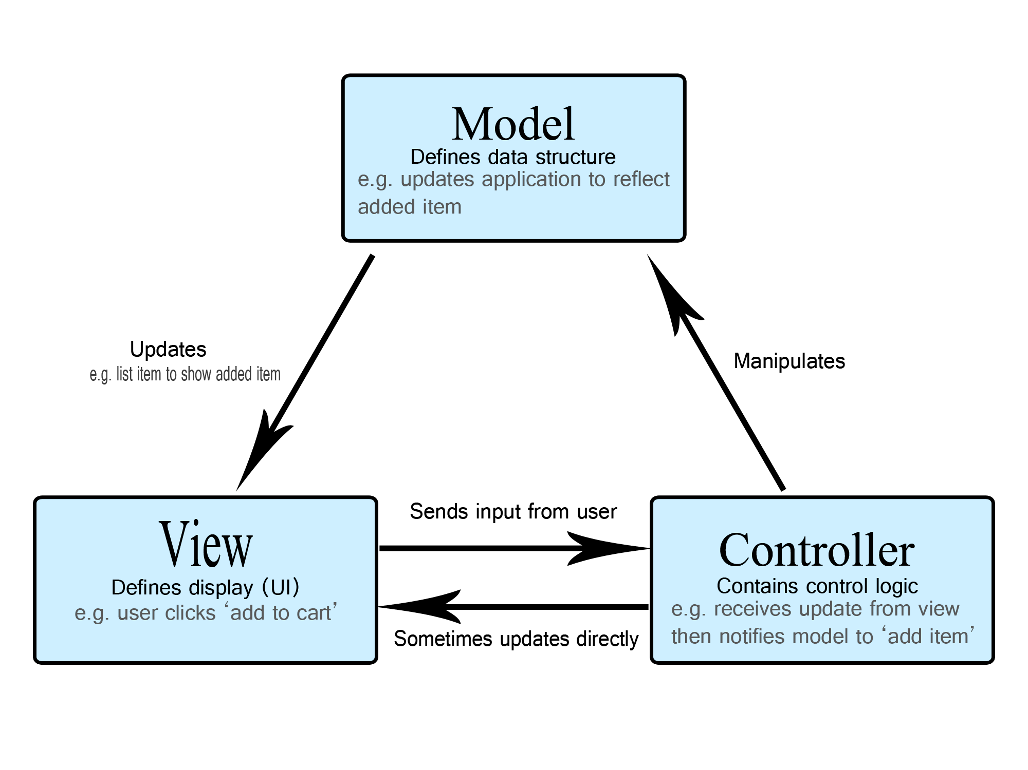
MVC

Slide 3
TRAIN
1. To book the Ticket it will take input from the user.
Here i.e., Train No
Depend upon the Train number it will fetch the Train name, source, destination, price
from the database.

Slide 4

Passenger
Passenger's details need to be entered to generate a ticket.
The Details are name, gender and age.
Ticket fare of the passengers varies depending on Gender and Age.
The ticket Fare for each passenger is calculated using the following rules
For age < = 12, fare is 50% of ticket price regardless of gender
For age > = 60, fare is 60% of ticket price regardless of gender
For Females, 25% discount on the ticket price

Slide 5
Train DAO
It was used from finding trains by train number and return the result to the main UI to tell the train is there are not.
In a further enhancement,
We can make a search module.
The search can be done not only by train number but with the name of the train, source, and destination of the train also.
DB manager
The DB manager is used for connecting Databases.
By using this module we can get the required data from the database like train details.

Slide 6
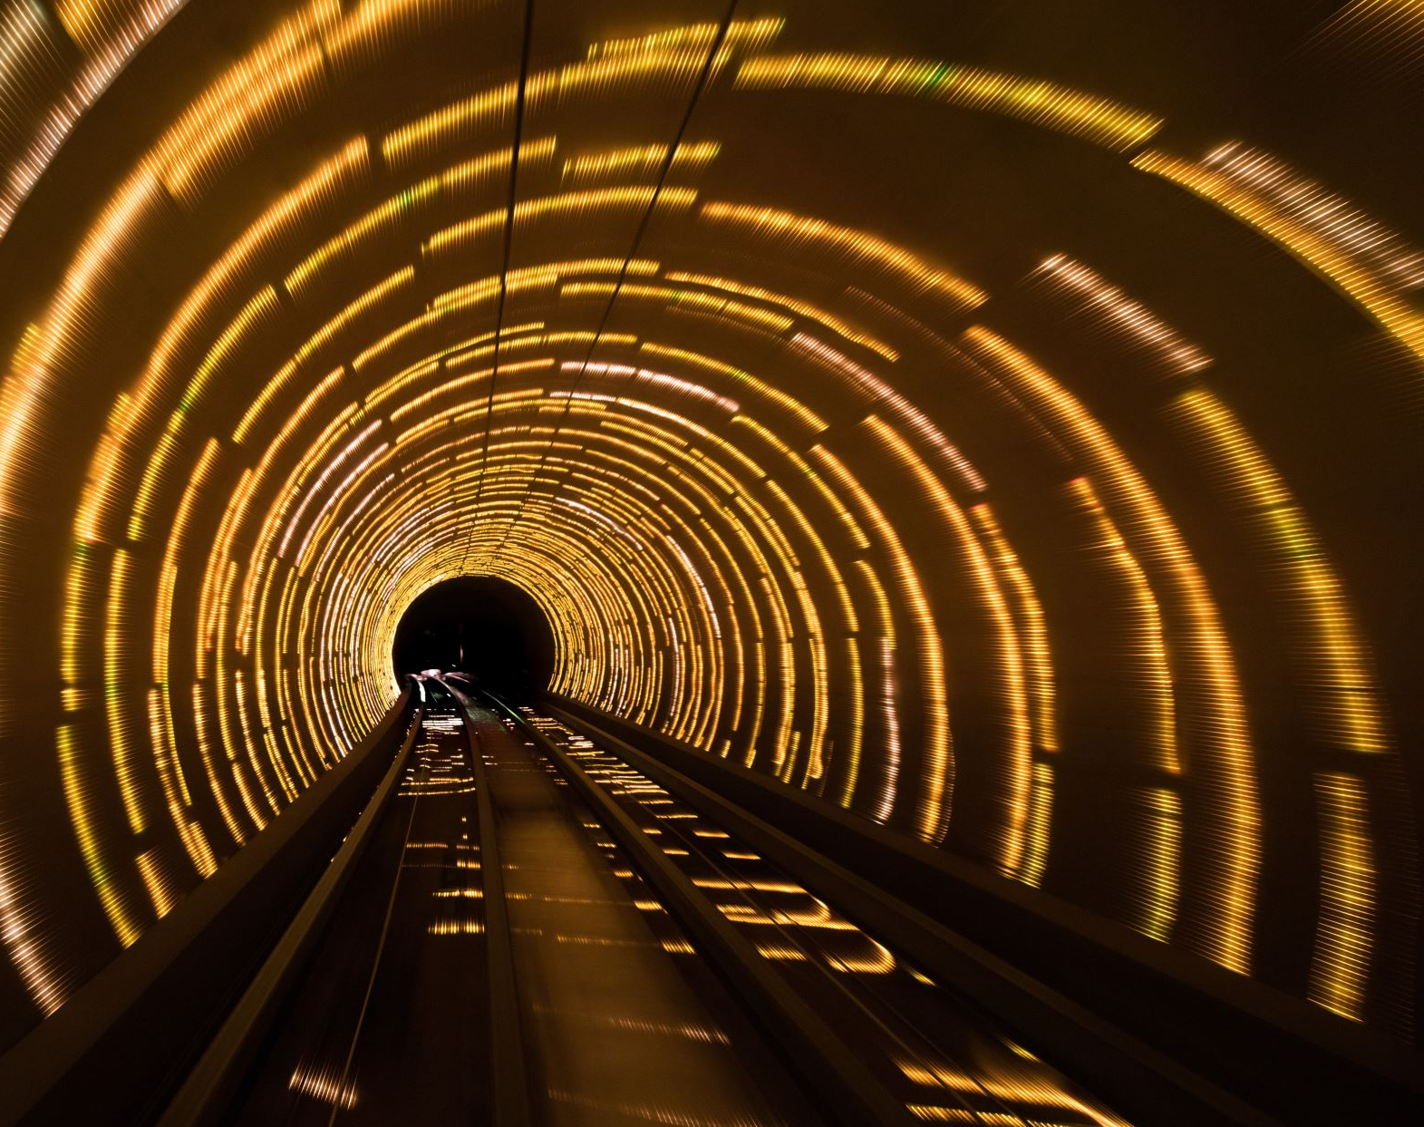
Ticket
Ticket class requires PNR number using first character of source station, first character of destination station, travel date(yyyy/mm/dd) and a running counter starting from 100
This class calculates the total ticket price for each passenger based on a certain criterion (age and gender)
After the above two functions the final ticket will be saved onto a file

Slide 7

Main
UI part of the project where the INPUTS are being getting from the USER.
Inputs like
Train number
Date of Travel
Number of passengers
a. NAME
b. AGE
c. GENDER
Data Processing methods are called here.
After getting all the inputs from the user, it process the data and displays the ticket details to the passengers.
If the details are not given correctly by the user then it again asks for the correct input from the user.

Slide 8
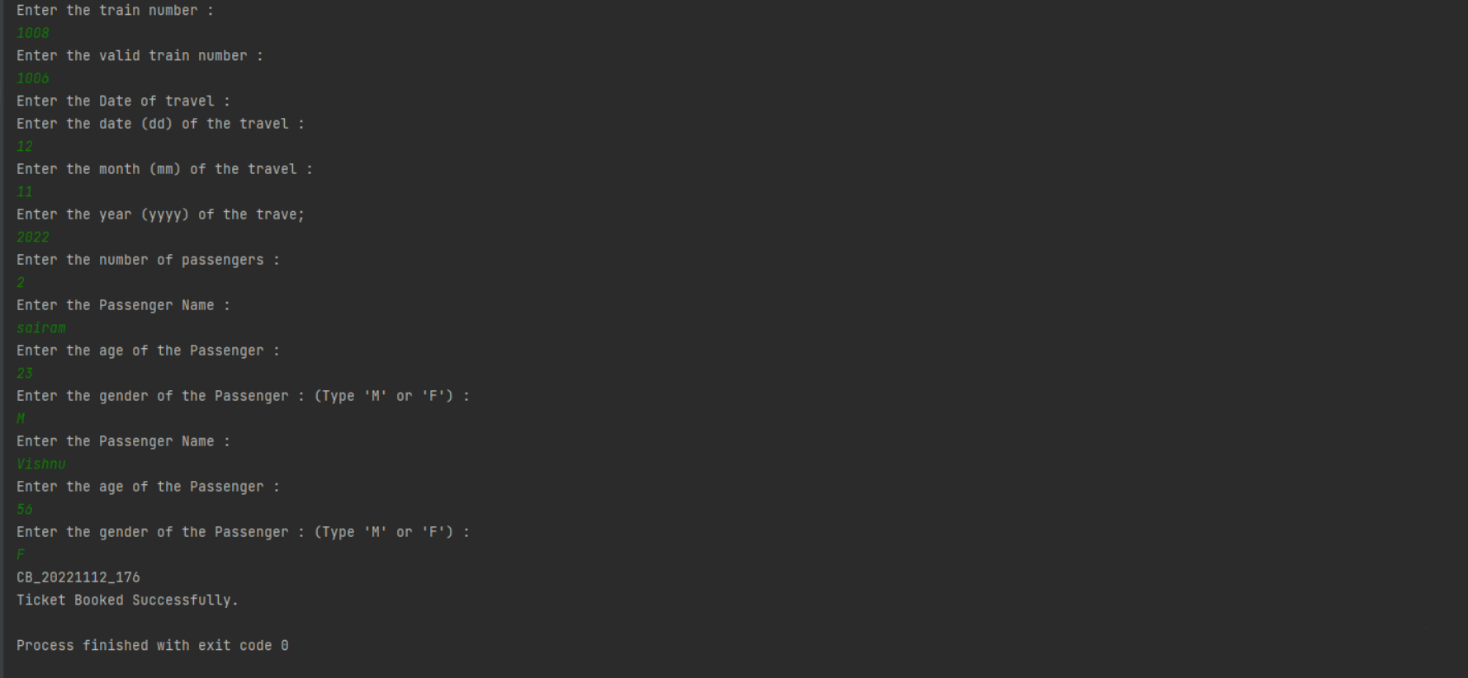
Screenshots

Slide 9
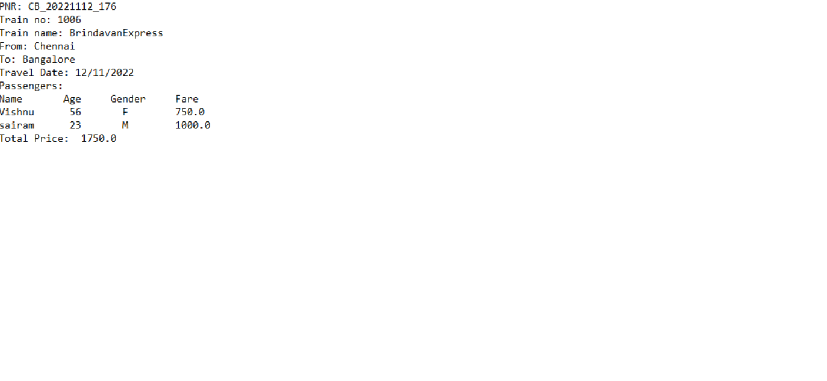

Slide 10
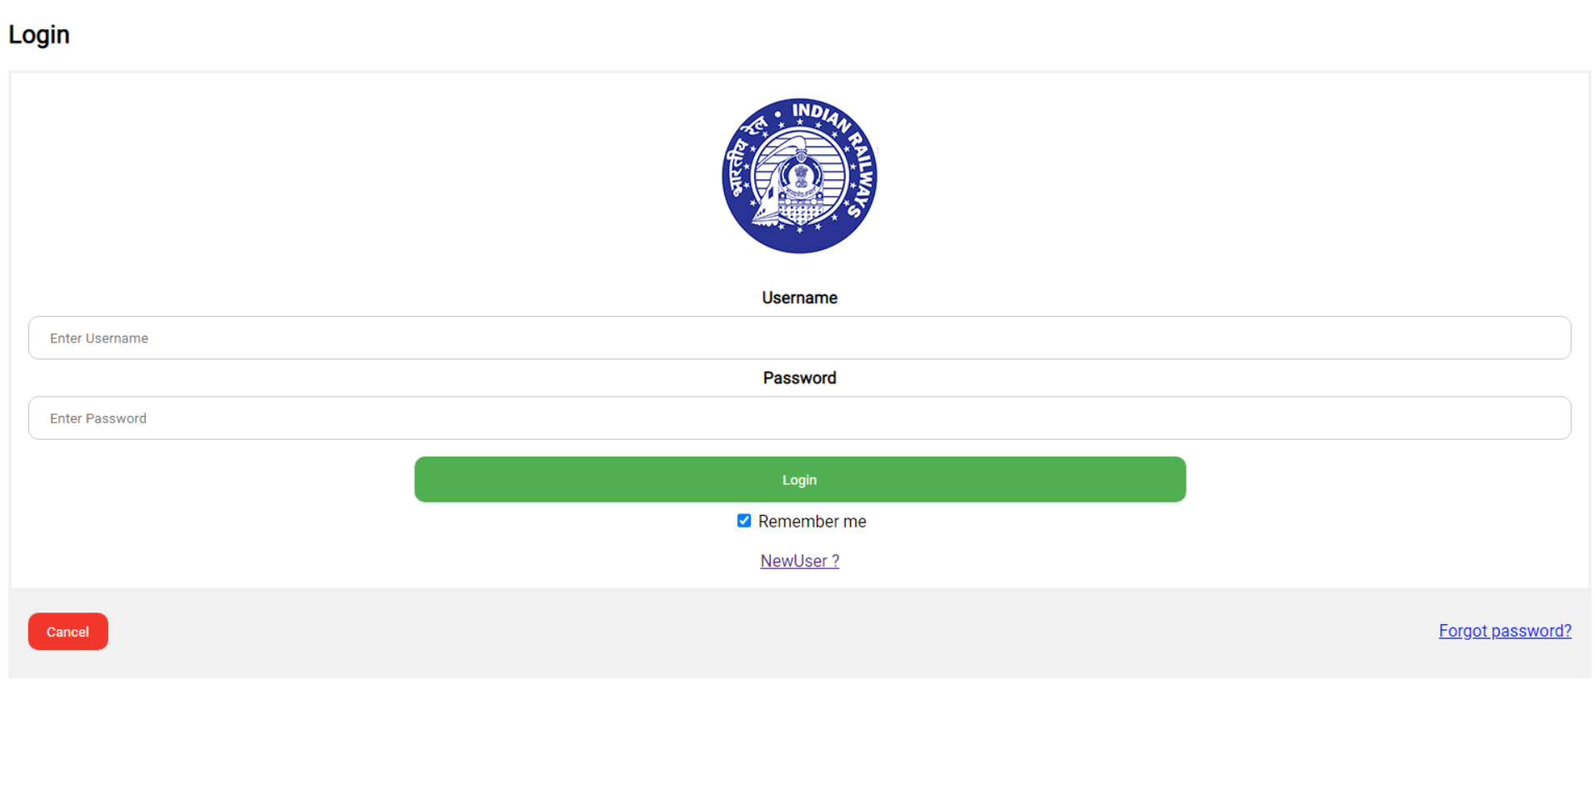
Web pages

Slide 11
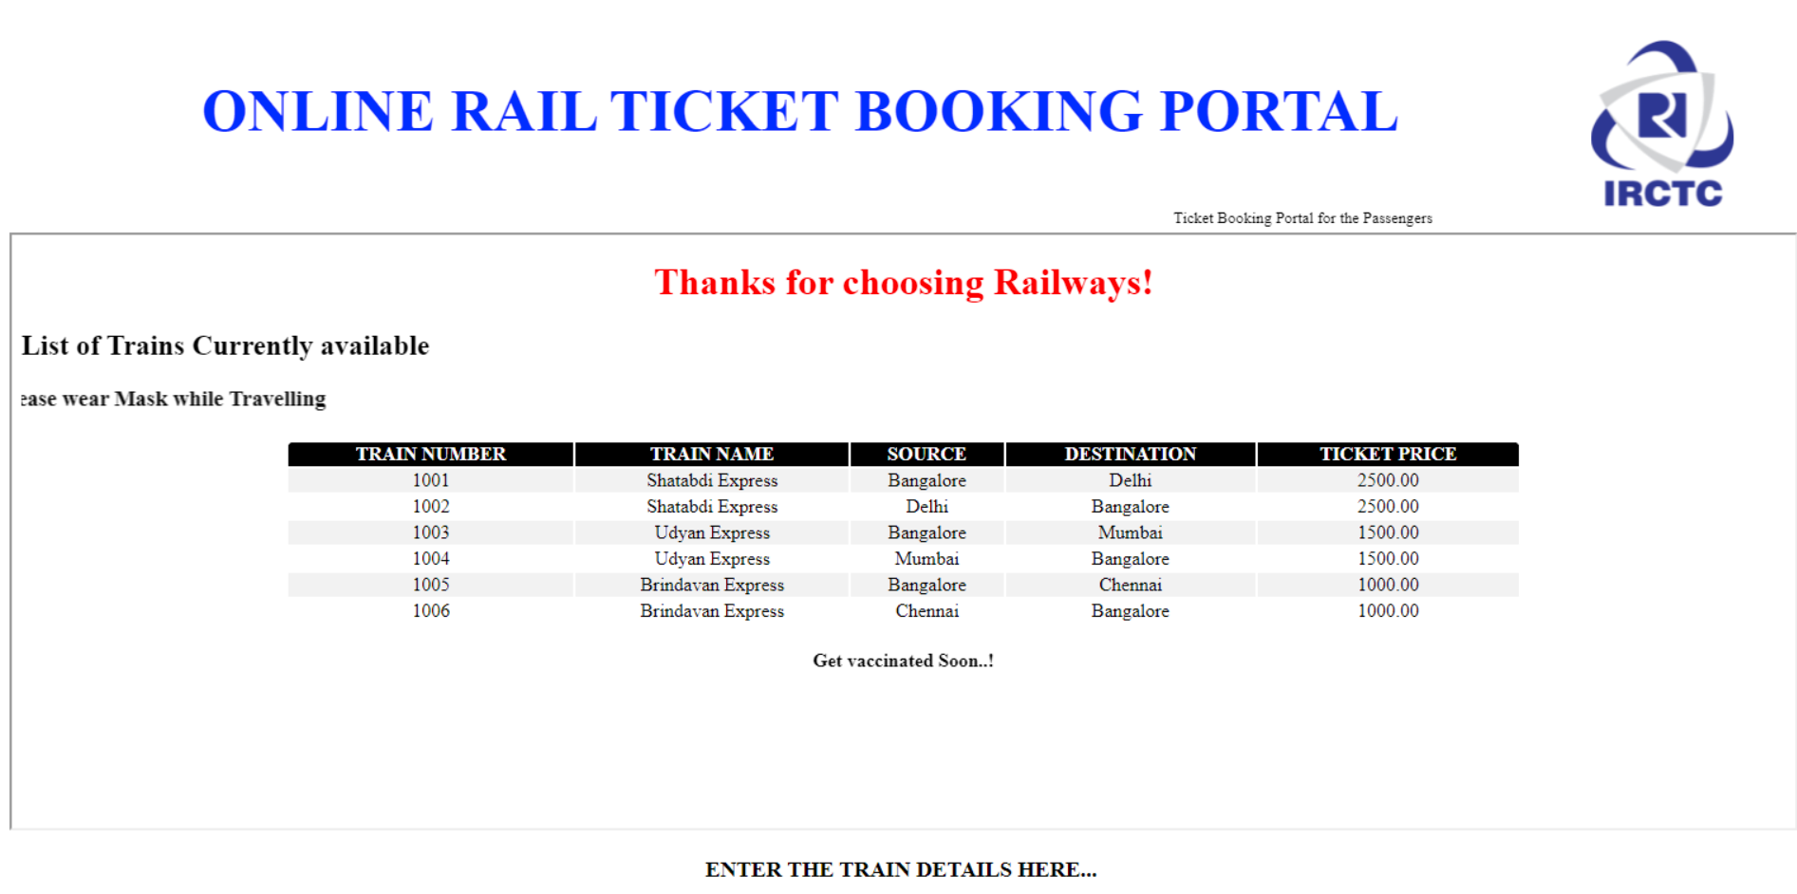

Slide 12
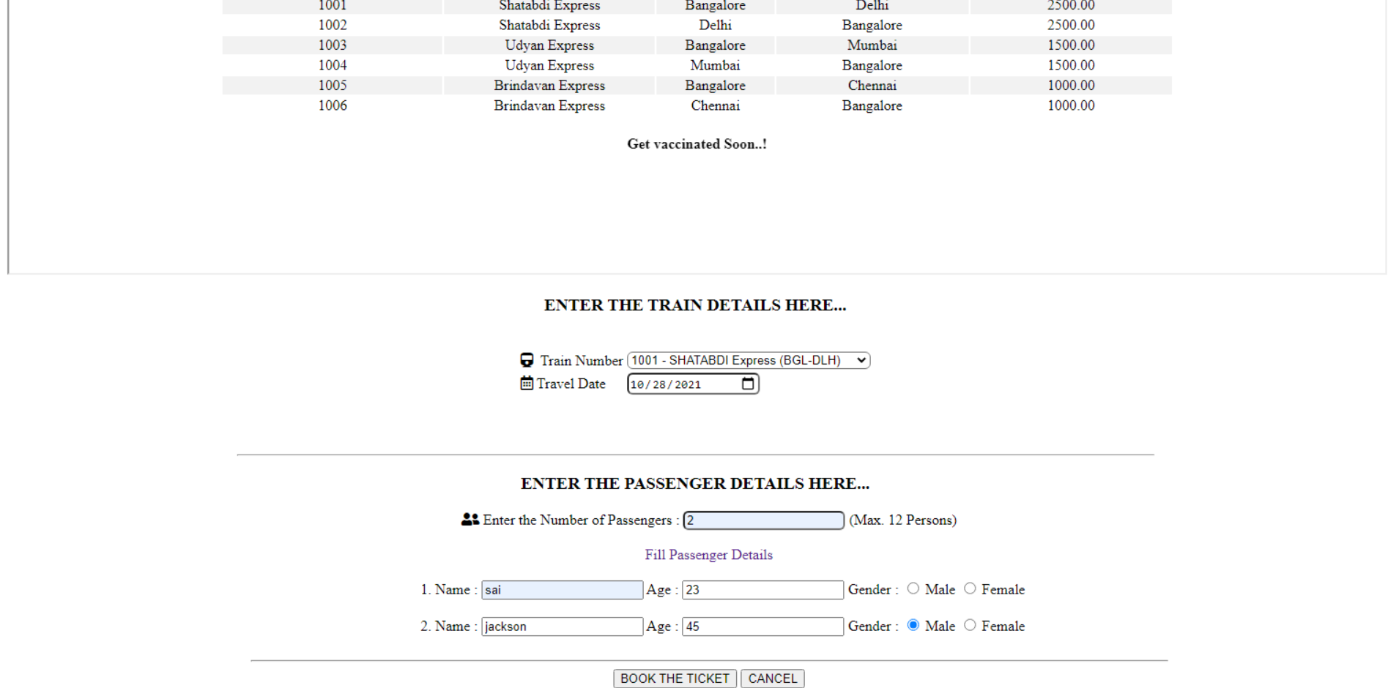

Slide 13
